Slide 1
Practice #2
Create Performance Task

Slide 2
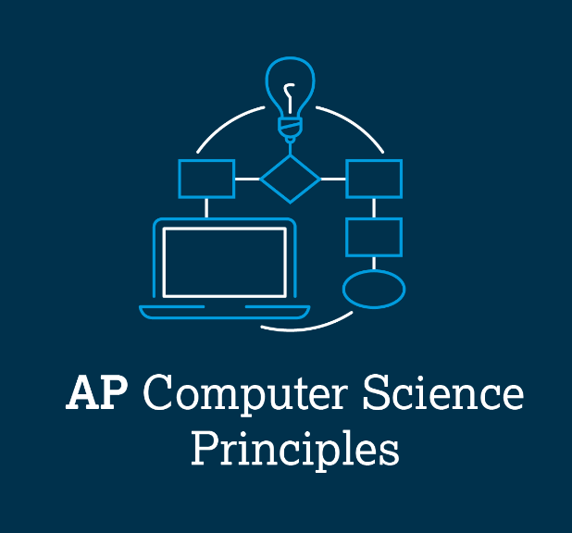
AP CSP Create Performance Task
Part of the AP Exam is to create a program that meets specific requirements:
Creates a list
Uses a list in a meaningful way
Has a function with a parameter
  Parameter affects function execution
Function has:
  If statement
  Loop

Slide 3
AP CSP Create Performance Task
Things to know about the Create PT:
You can work with a partner
Your classmates can help you
Your teacher cannot help you
You cannot use an assigned program for your project, but it can be similar
You will be given 9 hours of class time to work on the project

Slide 4
AP CSP Create Performance Task
The Create PT is like a remix project:
Start small and add components.
Start with what you know.
Don’t try something new that you don’t know how to do.
This isn’t a time to learn something new, but to show what you know how to do.

Slide 5
AP CSP Create Performance Task
The Create PT is like a remix project:
During a remix, you looked at completed programs and reviewed what you learned.
You either added to or created a program similar to your completed programs.
You can do the same thing for the Create PT.
Let’s look at a program from a mission and remix it to meet the requirements of the Create PT.

Slide 6
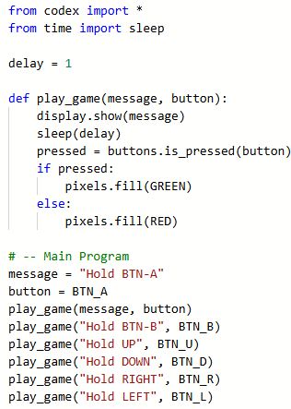
Practice #2
In CodeSpace, go to the Sandbox.
Open the project: Display_parameters
Go to File Save As… and rename the file PT_Practice2
Review the code.
What PT requirements does it meet?
What PT requirements does it lack?

Slide 7


Practice #2
PT Requirements
Creates a list
Uses a list in a meaningful way
Has a function with a parameter
  Parameter affect function execution
Function has:
  If statement
  Loop

Slide 8
Practice #2
This project doesn’t meet very many requirements…yet.
But it won’t take much work to meet some more of the requirements.
Start with creating a list for the button presses and buttons (message, button).
This is the information passed to the parameters.

Slide 9

Practice #2
The list can be a matrix and include both the message and the button.
It may look like this:

Slide 10
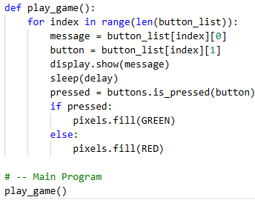

Practice #2
Replace all the function calls in the main program with a loop in the function.
Traverse the loop to access the elements in the matrix.
You won’t need any parameters … yet!

Slide 11
Practice #2
Revisit the PT Requirements:
Creates a list
Uses a list in a meaningful way
Has a function with a parameter
  Parameter affects function execution
Function has:
  If statement
  Loop

Slide 12
Practice #2
Adding a list and traversing means the program meets more requirements.
The last requirement to meet is to add a parameter to the function
Use the parameter in an if statement.
One way to do this is to have an easy, medium and difficult level.

Slide 13
Practice #2
Adding a parameter for the difficulty level:
Here is an example of difficulty levels
  Easy: delay = 1.5 second, loop 5 times
  Medium: delay = 1.0 seconds, loop 10 times
  Hard: delay = 0.5 seconds, loop 15 times
Add a parameter to the function.
Use a button press to select easy, medium or hard.
Use an argument in the function call for the level.
This is similar to the if statement added to the function in Practice1
Try doing this code on your own.

Slide 14
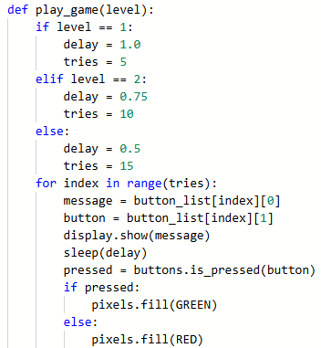
Practice #2
The parameter and if statement could look like this:

Slide 15
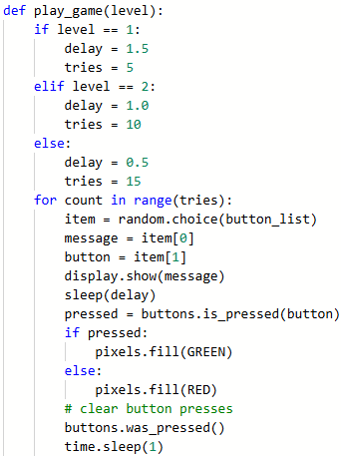
Practice #2
Revisit the PT Requirements:
Creates a list
Uses a list in a meaningful way
Has a function with a parameter
  Parameter affects function execution
Function has:
  If statement
  Loop

Slide 16
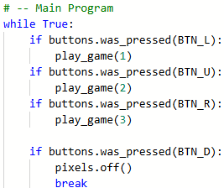
Practice #2
The requirements are met!
Two more things to do.
First, complete the main program by coding the button presses.

Slide 17
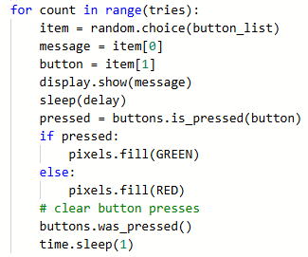
Practice #2
Select a random item from the list instead of traversing it.
Clear the button presses so the next game doesn’t start automatically

Slide 18
Practice #2
Optional:
Make any other changes you want to make the game uniquely yours.
Possibilities:
  Add an introduction so the player knows what to do
  Add a global counter to keep track of correct presses
  Add an ending message that displays the number of correct button presses

Slide 19
Practice #2
Now that you have seen an example of modifying the Display program, can you think of any other ways to remix the project for the Create PT?
Go to the Activity Guide and write down any more ideas you have for modifications.

Slide 20
Practice #2
Final considerations.
Your program needs to have input and output.
  Be prepared to explain the input and output of this program?
If you create a program similar to this for the Create PT, be prepared to state the purpose and intended users.
  Note: the purpose isn’t WHAT it does, but WHY it was created.
  WHAT is the function. In this program, the function code be to play a button press game.
  The WHY is the reason for creating it. For this program, the purpose could be for entertainment, to beat boredom, or test your eye-hand coordination.

